Slide 1


Automating the Check-In with Mobile Camera Technology
MUJ Attendance 2.0

Slide 2
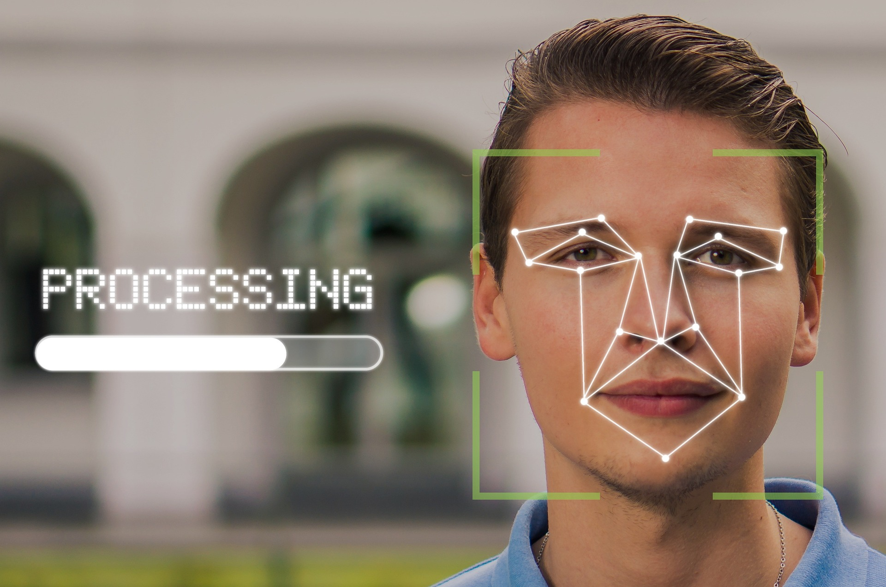
Agenda
Attendance System using mobile camera.

Slide 3

INTRODUCTION
Attendance system using mobile camera is an innovative way to track employee attendance. It uses the camera of a mobile device to take pictures of employees as they enter and leave the office and stores the images in a secure database. This system eliminates the need for manual tracking and provides a more efficient way of tracking employee attendance.
This system is easy to use and requires minimal setup. It can be used in any location and is capable of tracking multiple employees at once. Additionally, it is cost-effective and offers a secure way of tracking employee attendance.

Slide 4

Benefits of Attendance System using Mobile Camera
Eliminates the need for manual tracking, which can be time-consuming and prone to errors.
Using this system also saves money, as there is no need to purchase additional hardware or software.
It is easy to use and requires minimal setup, making it an ideal solution for businesses of any size.
It Reduces the chaos during the end of class for getting attendance marked.

Slide 5

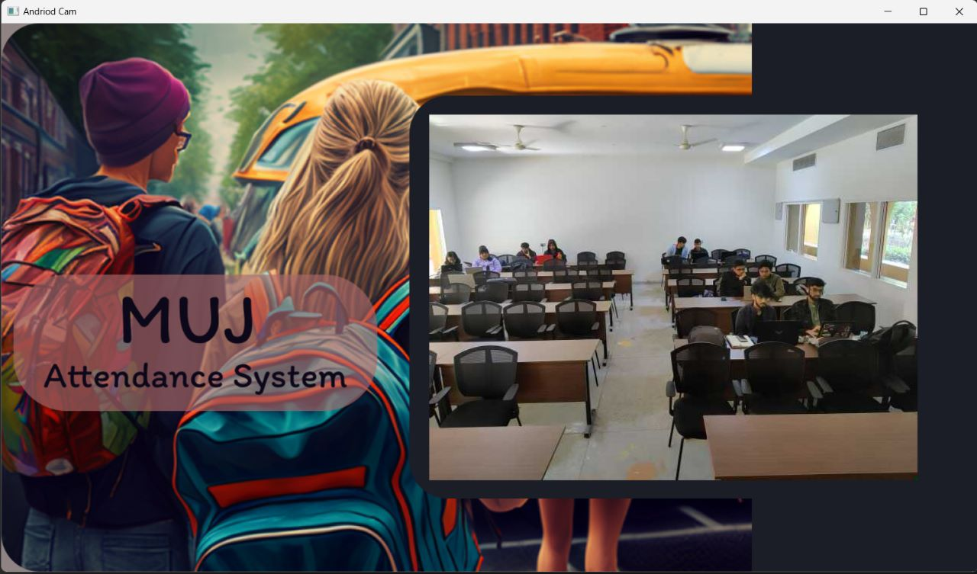
Project Features
Automated Email notifications
Attendance history
Multiple face recognition
Real-time attendance tracking
Remote access

Slide 6
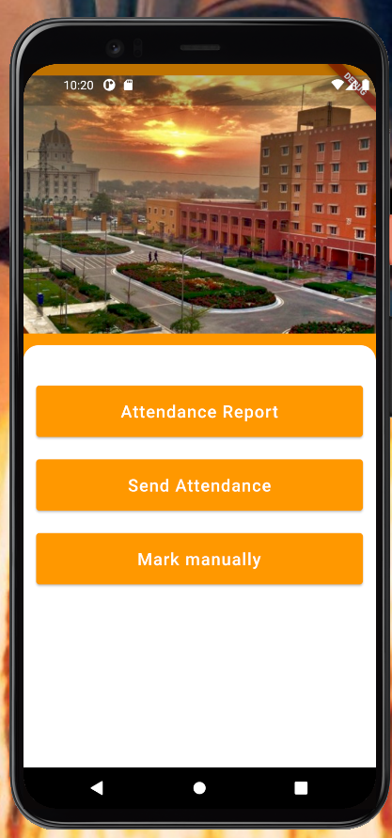
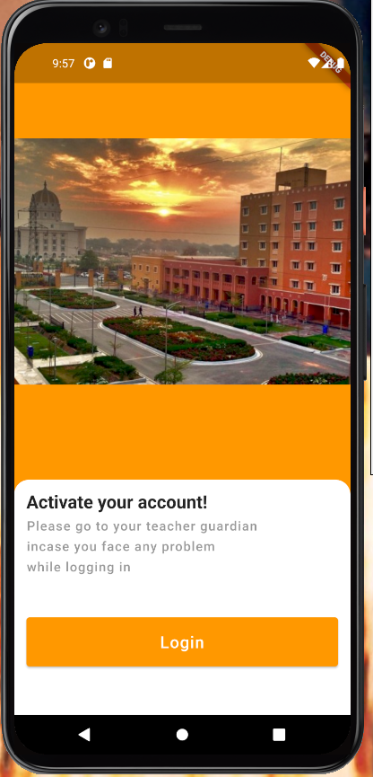
APP UI

Slide 7

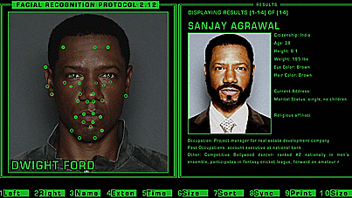
What’s next

Slide 8

More Features
Cloud Based Online Deployment/Mobile App Integration
Integration with other systems
Liveness Detection
Multi-language support
Automatic report generation
Improved security(Token Auth)

Slide 9



That IT Guy
Meet The Team
Arpit Singh Gautam
Manik Tyagi
Ishaan Khullar

Slide 10

THANK YOU

